Slide 1


LLM微调指北
以RWKV为例 by 刘潇 2023.11.18

Slide 2
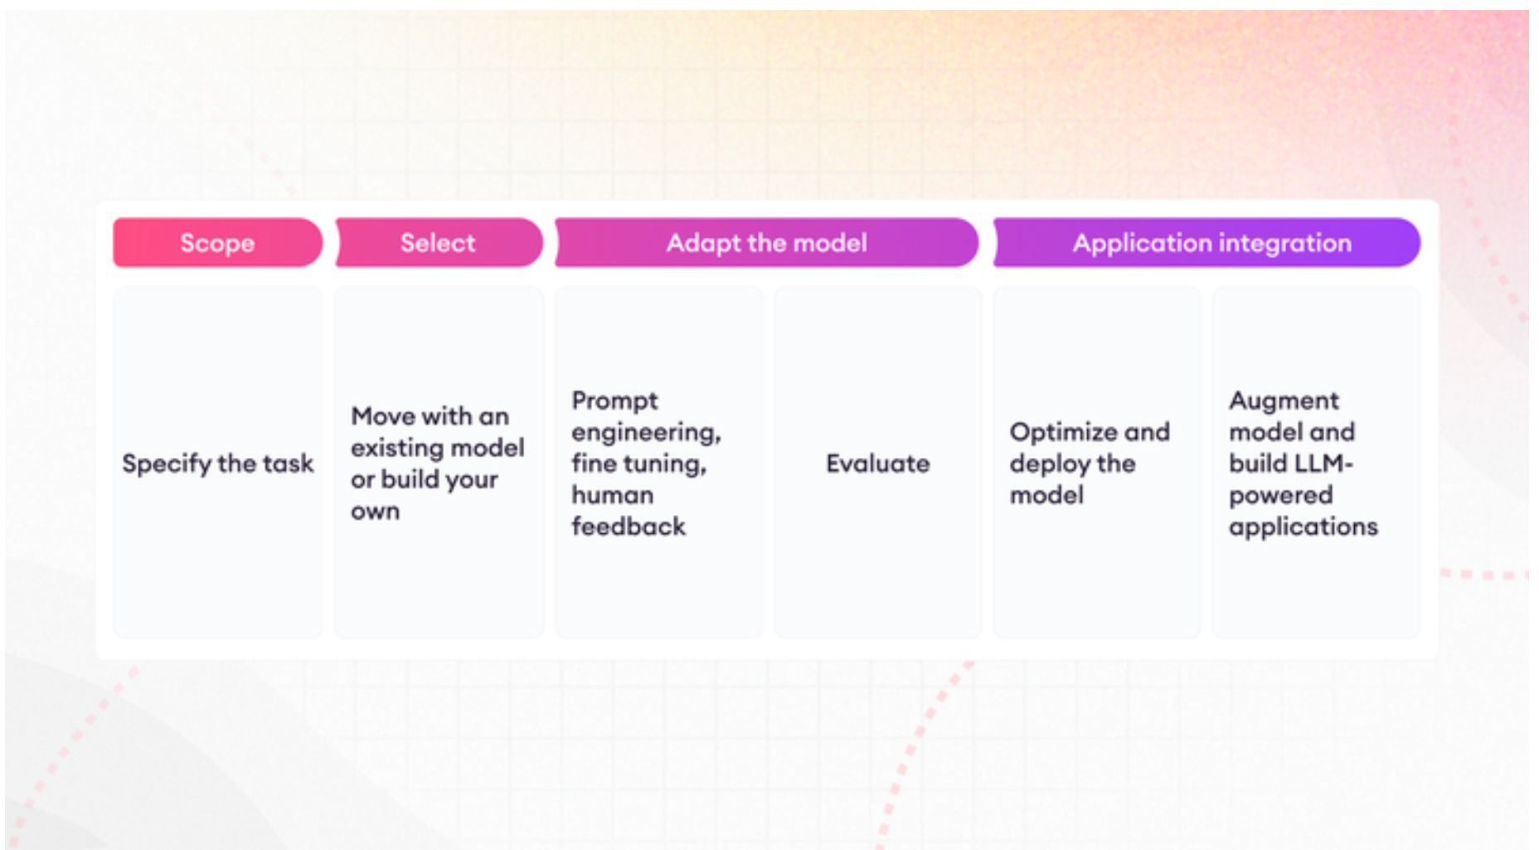
Fine-tuning large language models (LLMs) in 2023 | SuperAnnotate

Slide 3
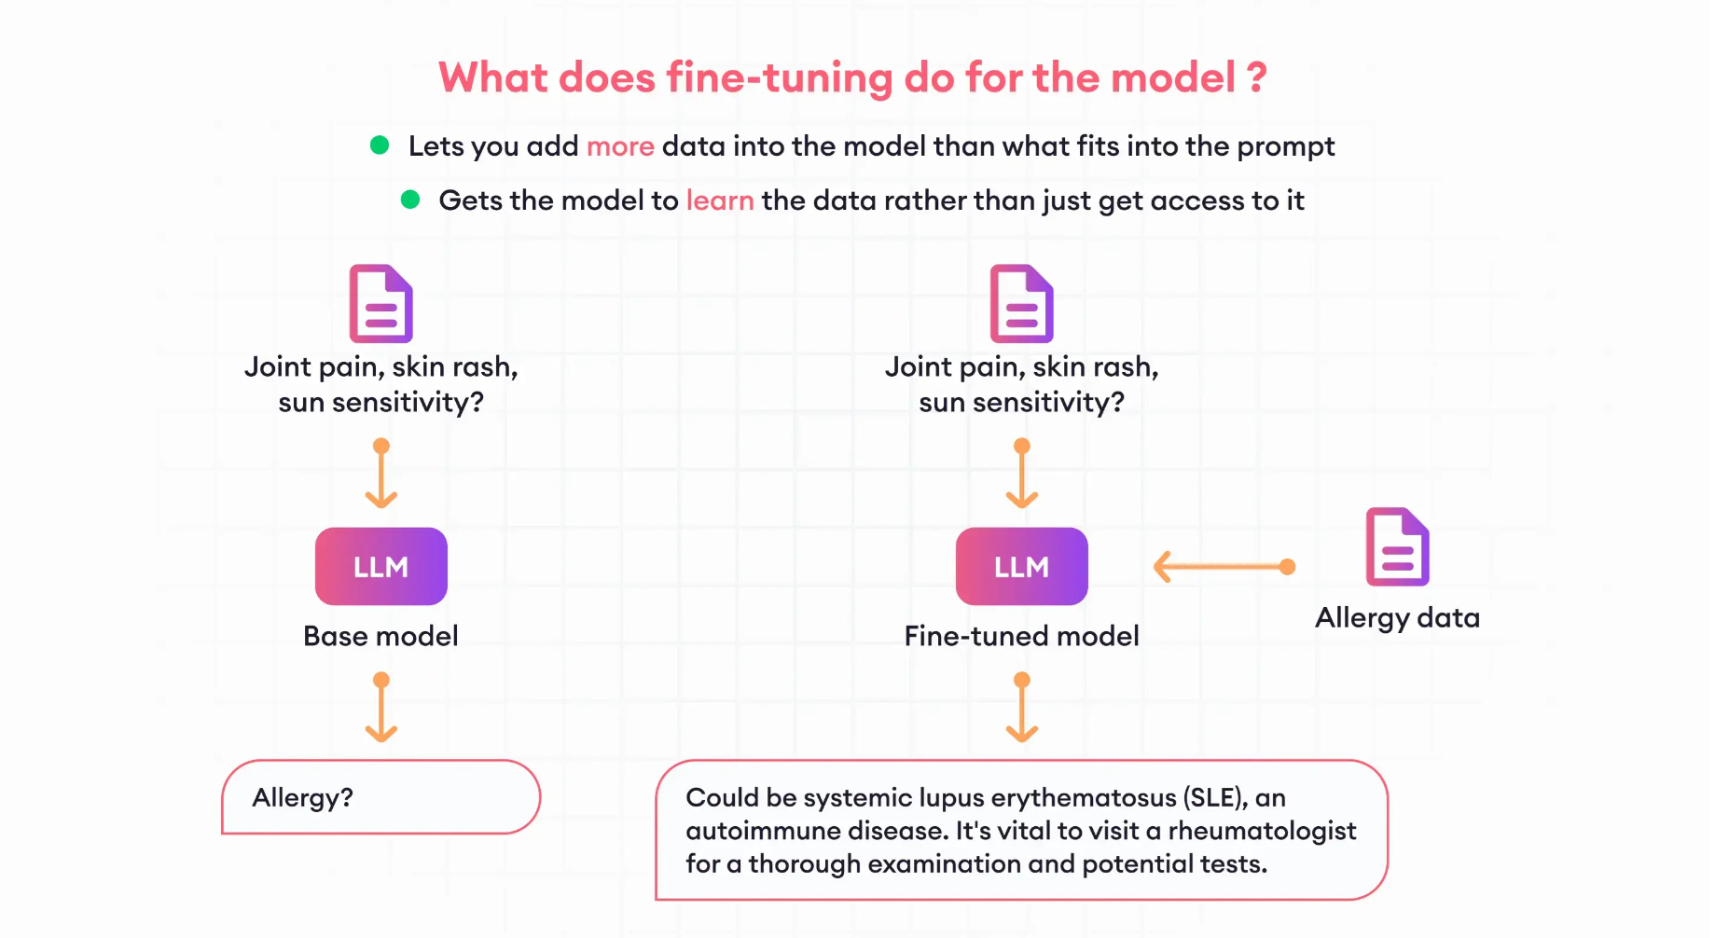

Slide 4
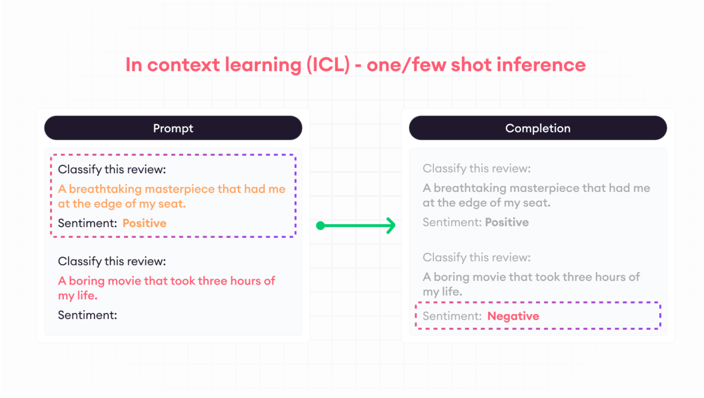

Slide 5
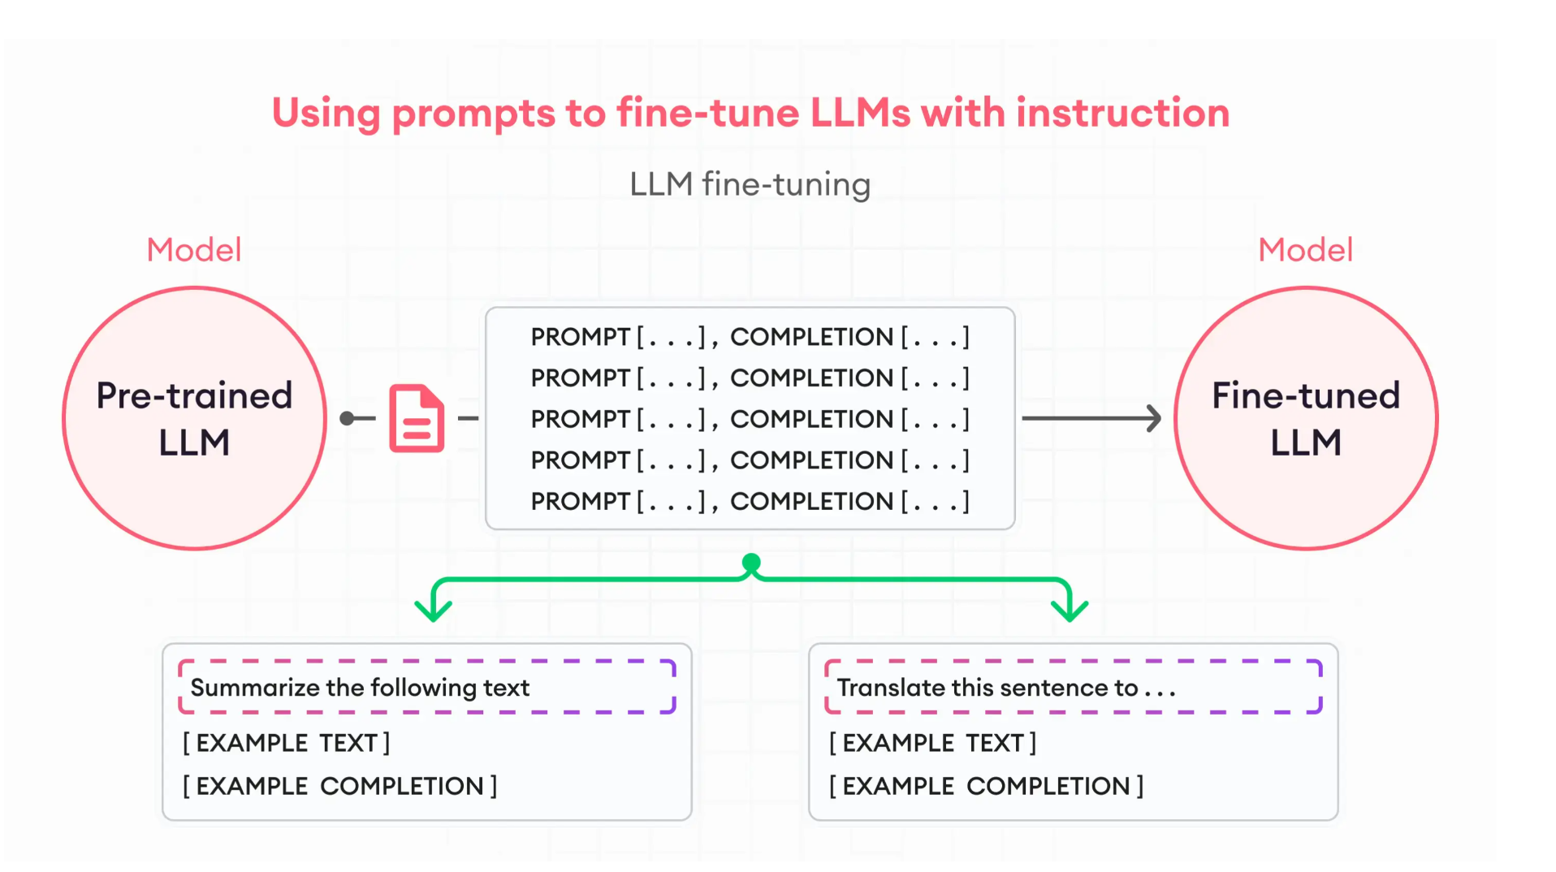

Slide 6
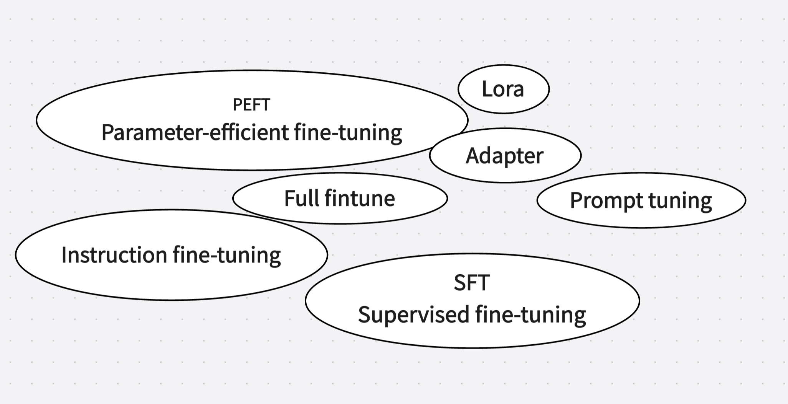

Slide 7
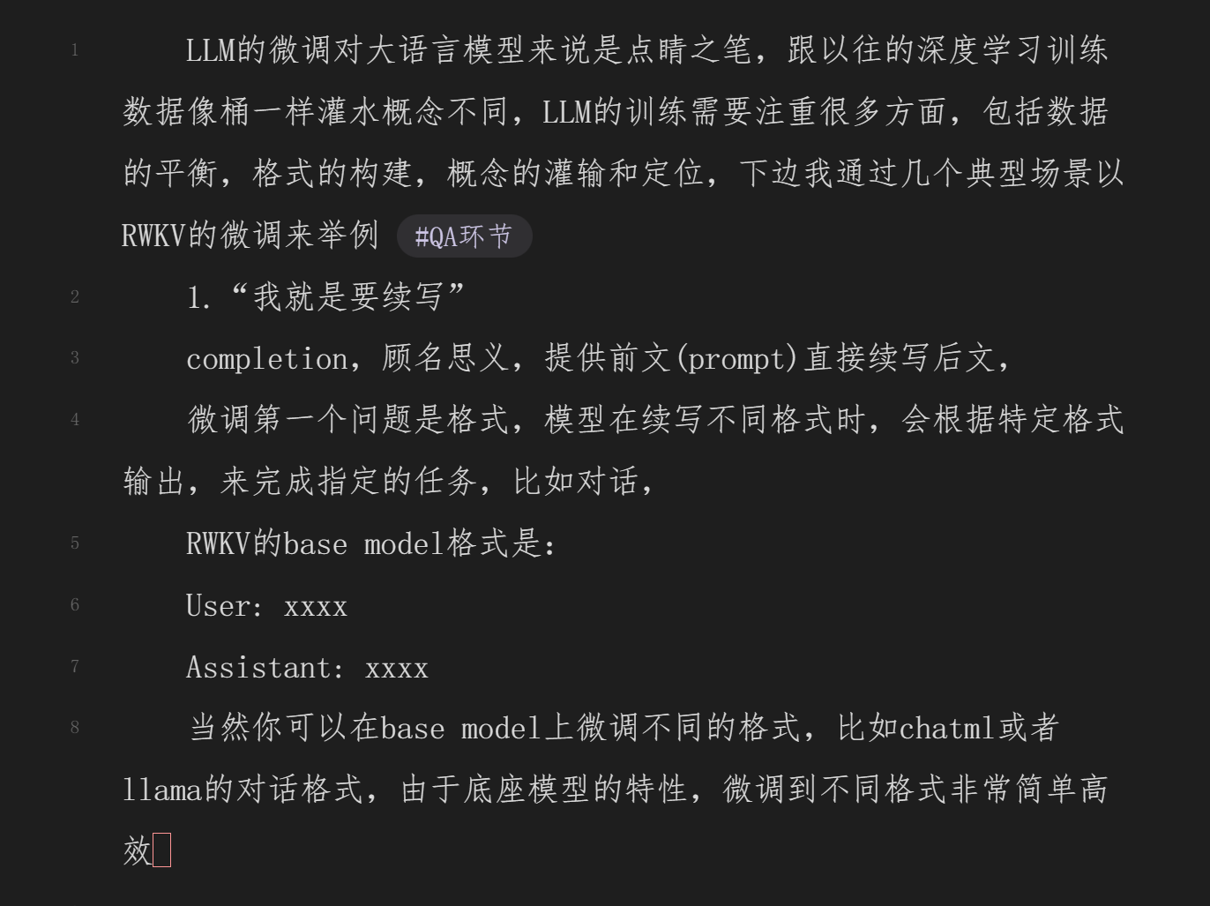

Slide 8
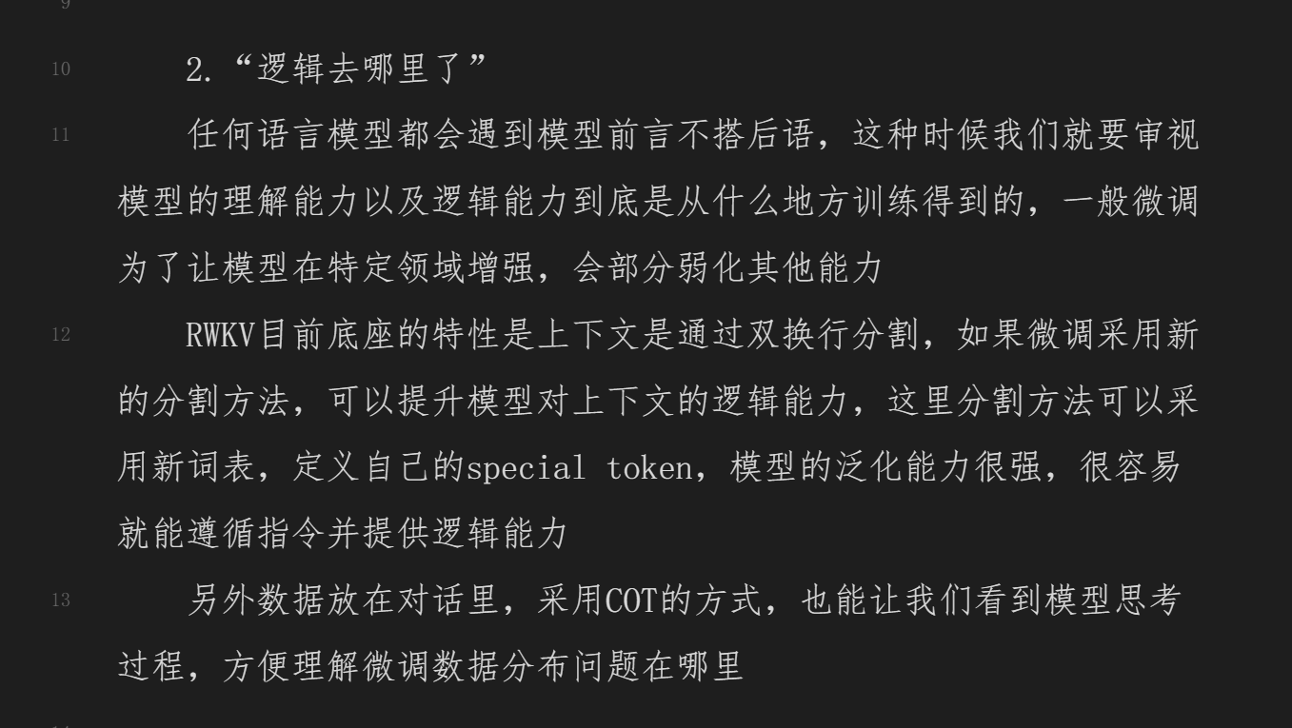

Slide 9
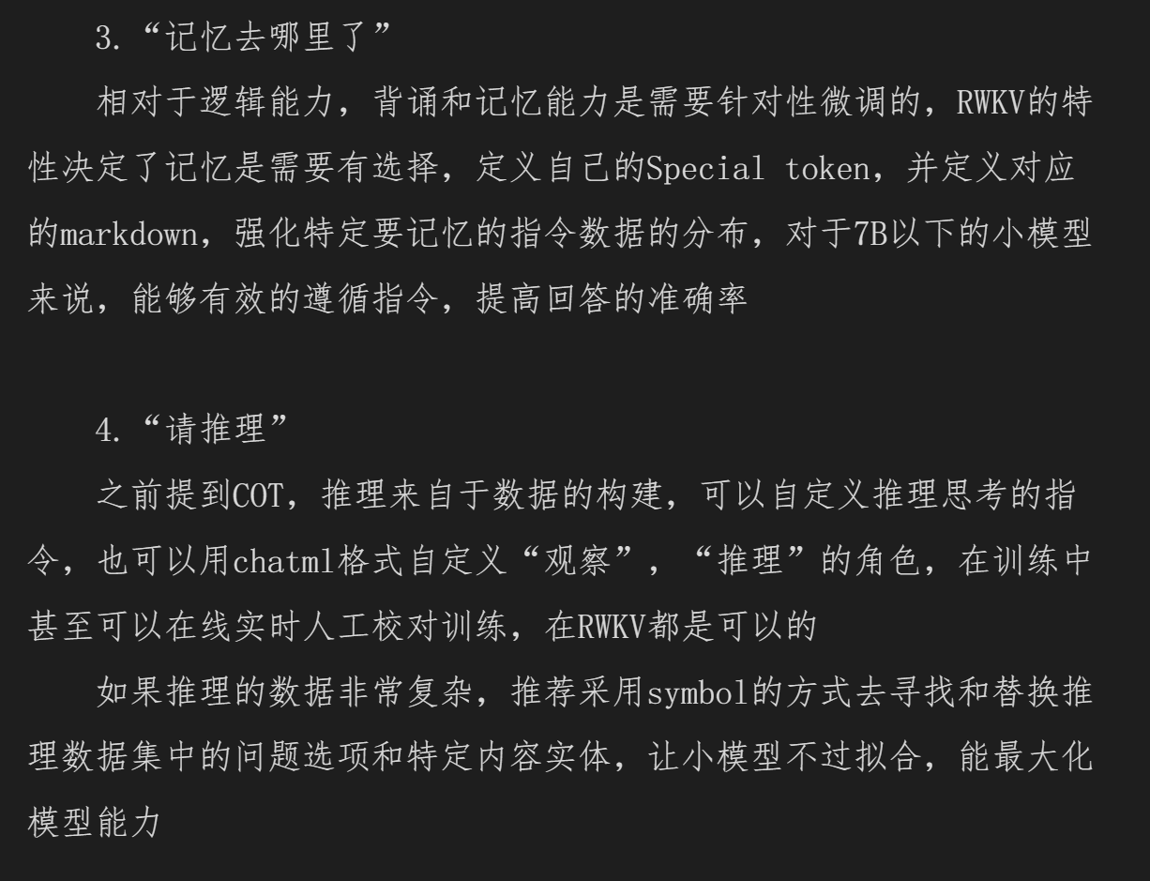

Slide 10
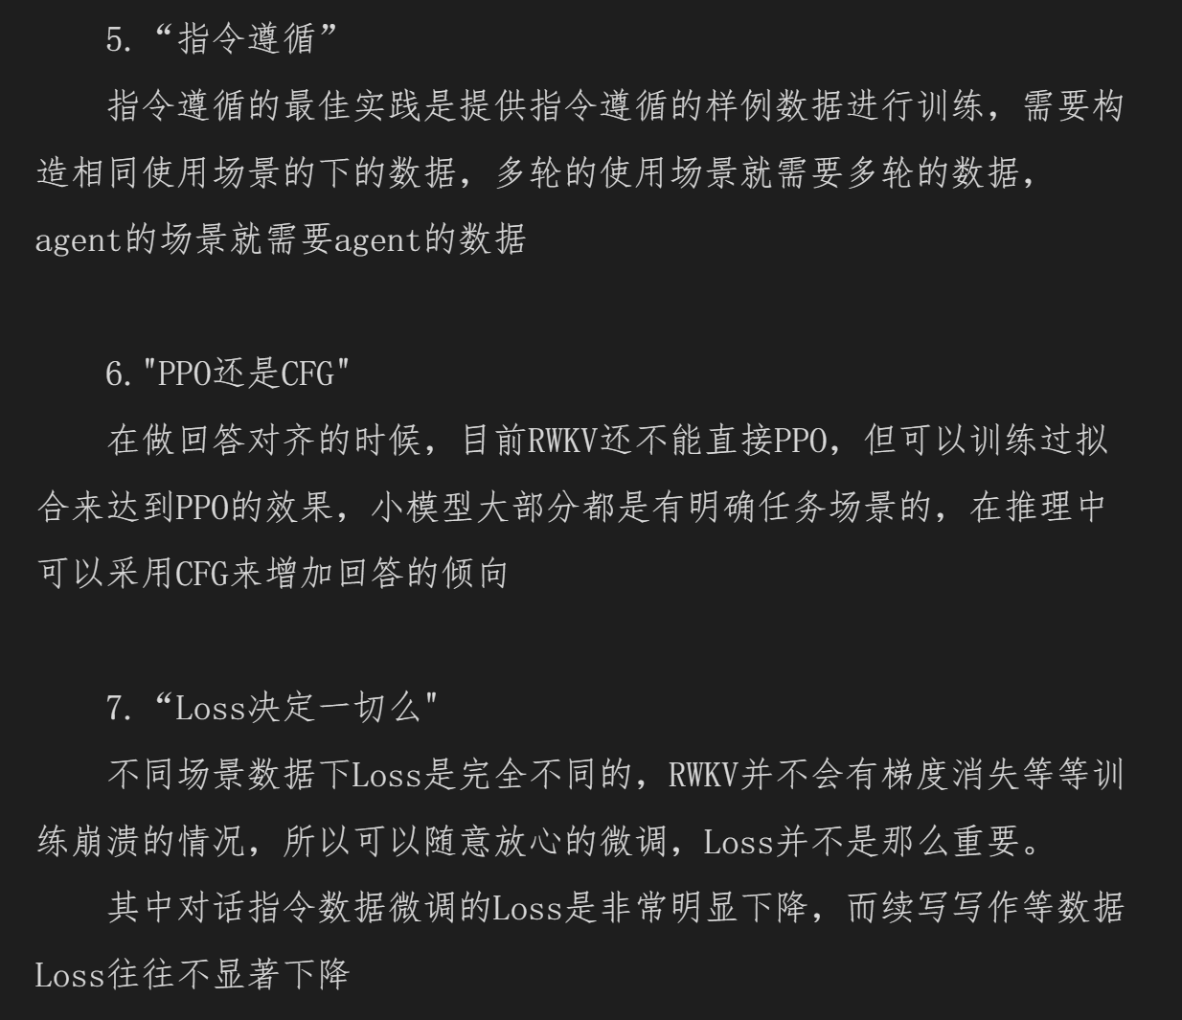

Slide 11
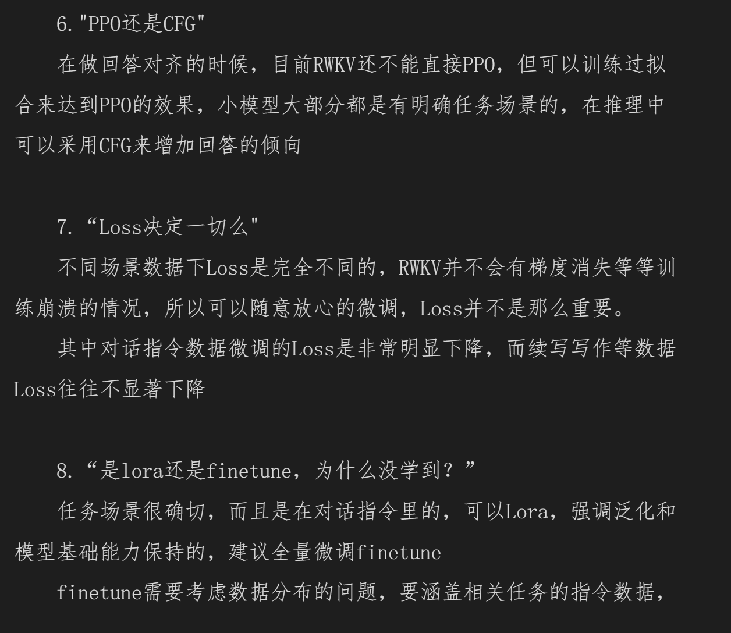

Slide 12
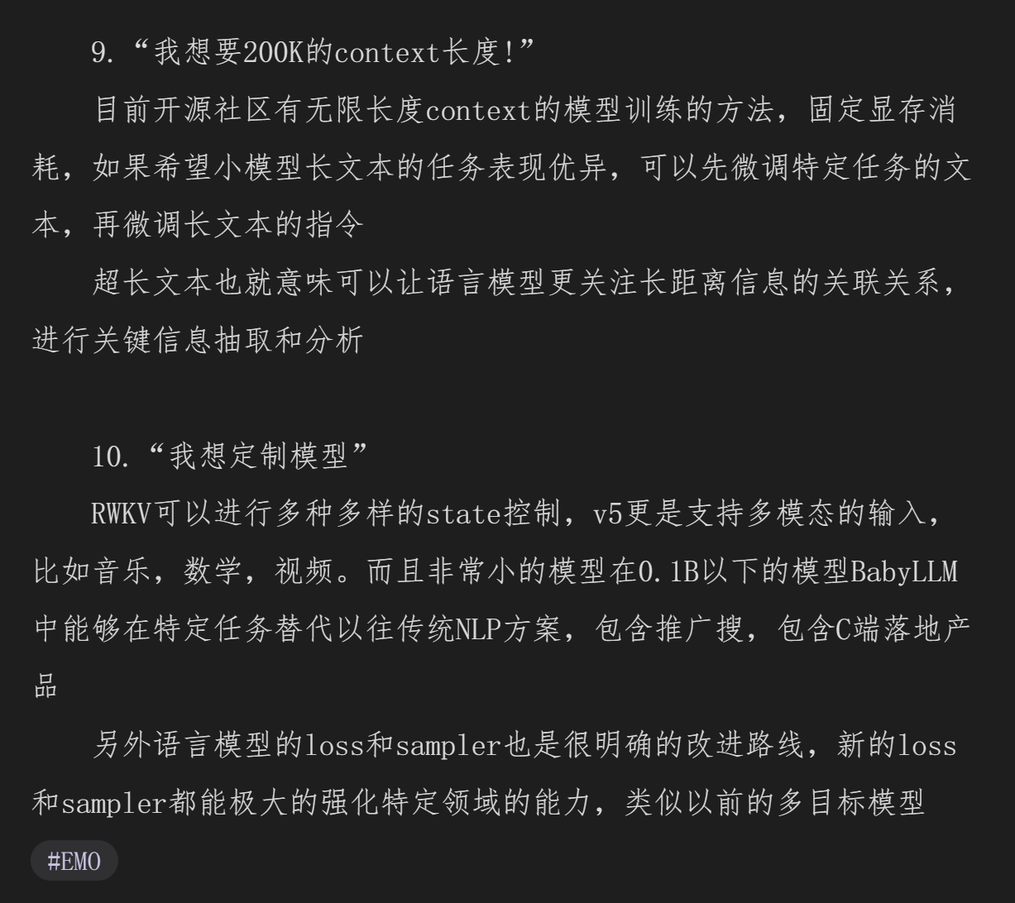

Slide 13
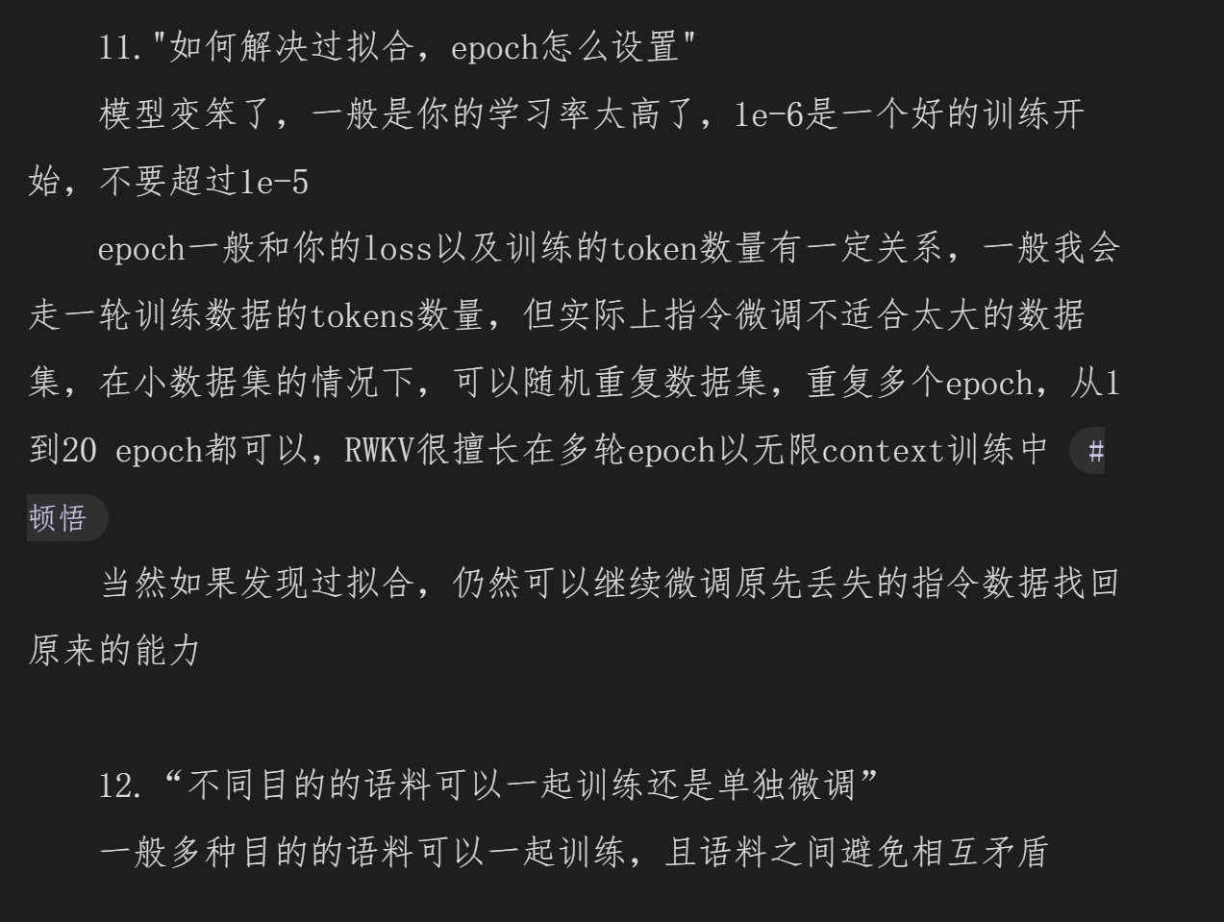

Slide 14
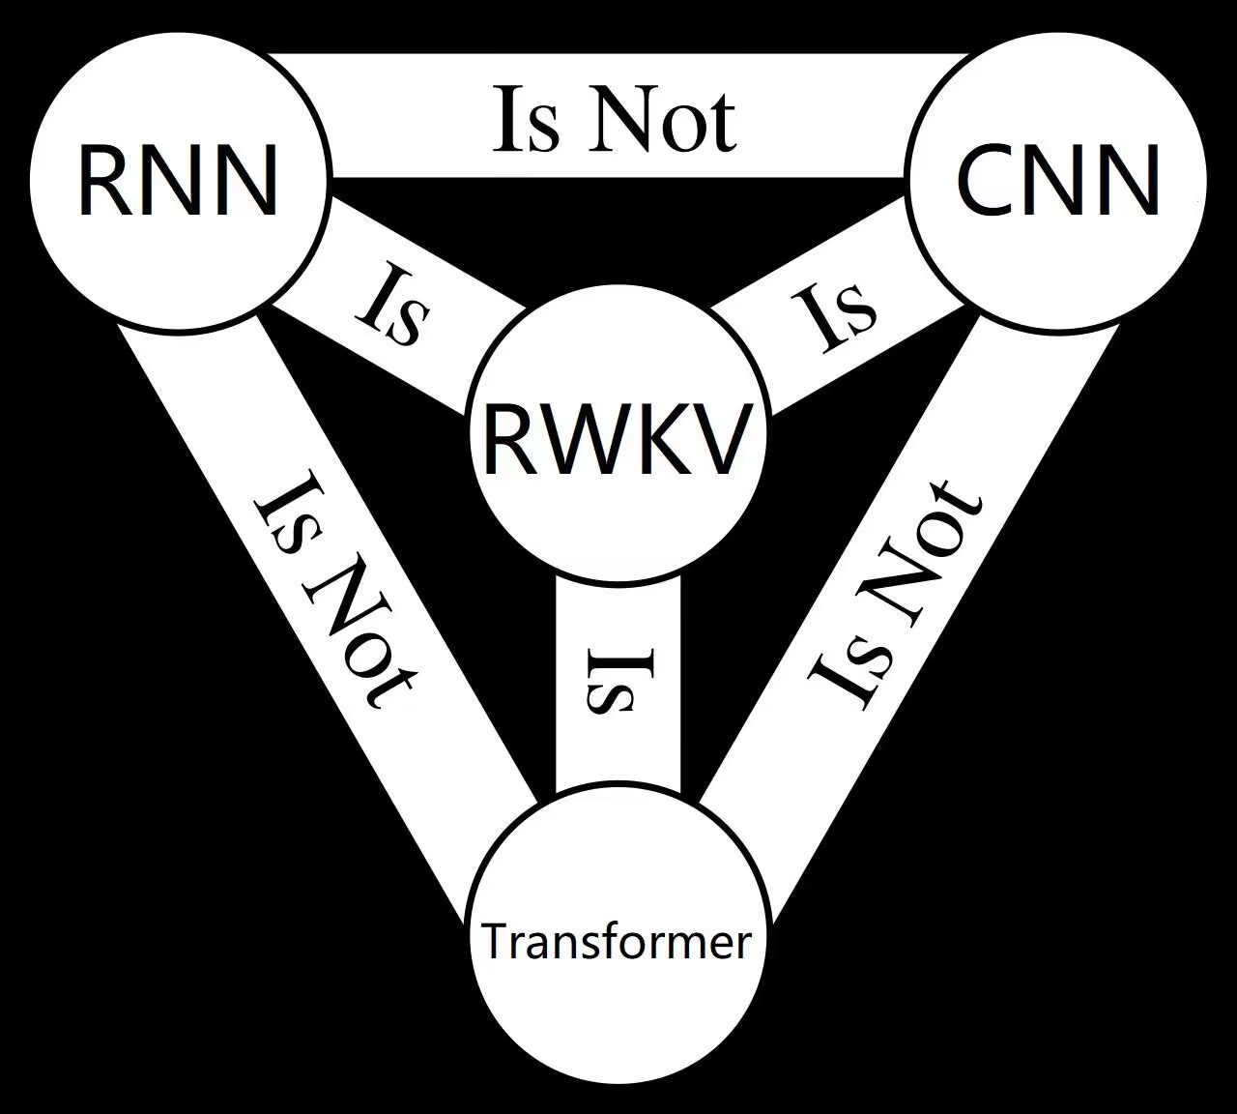
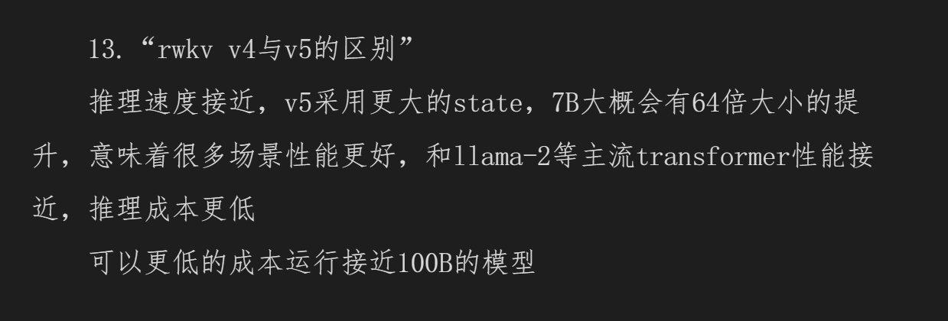
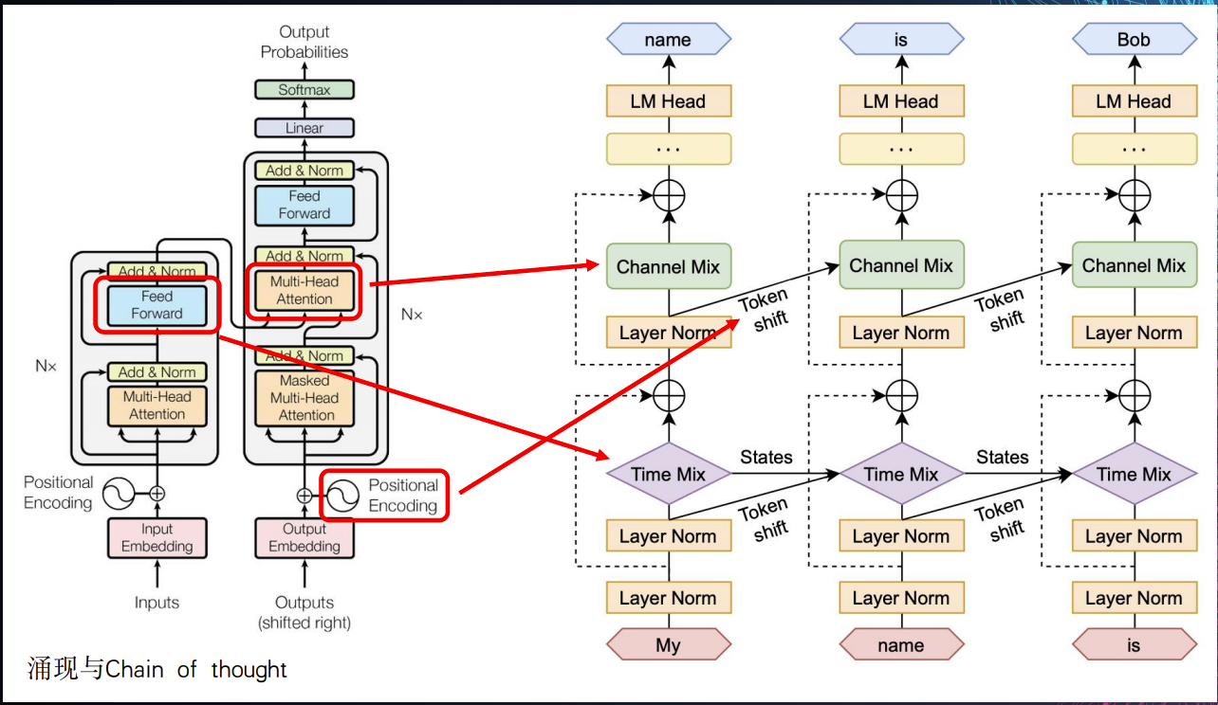
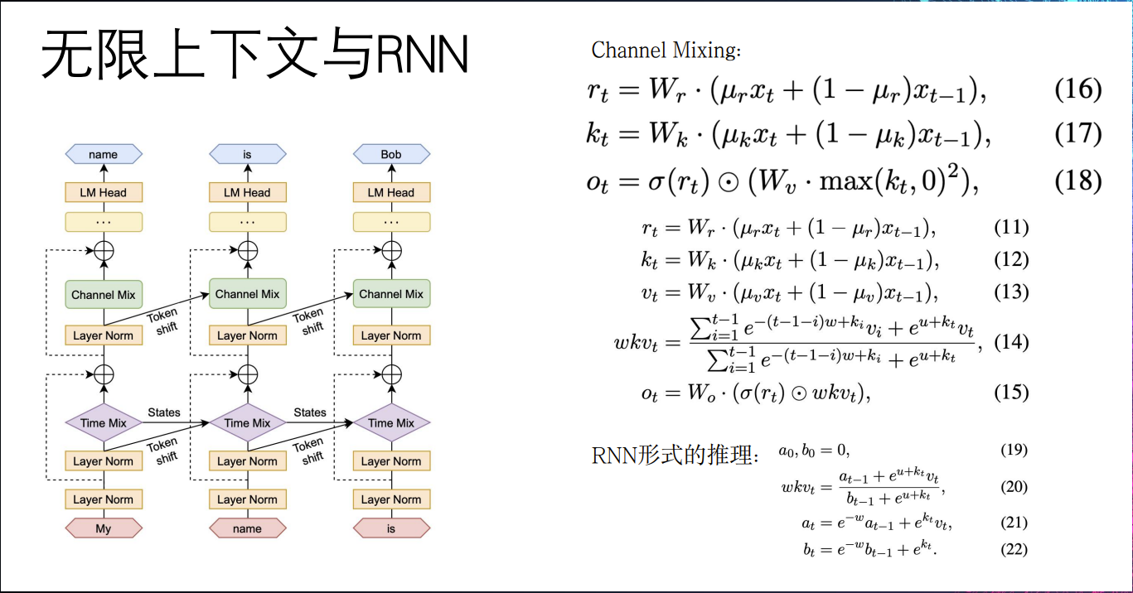

Slide 15
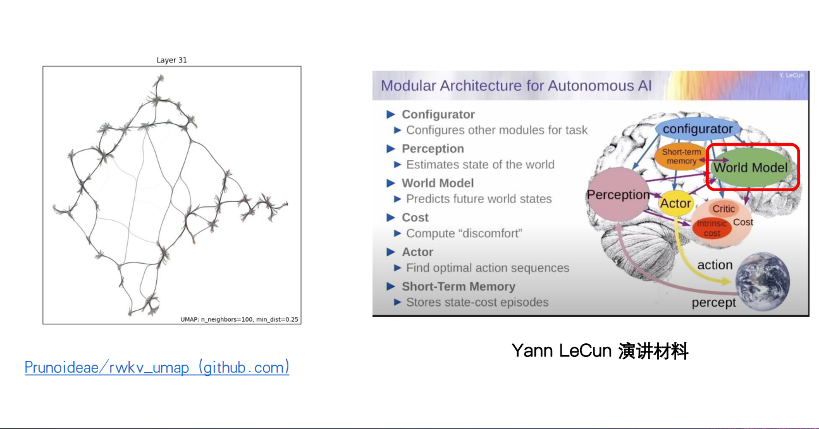

Slide 16
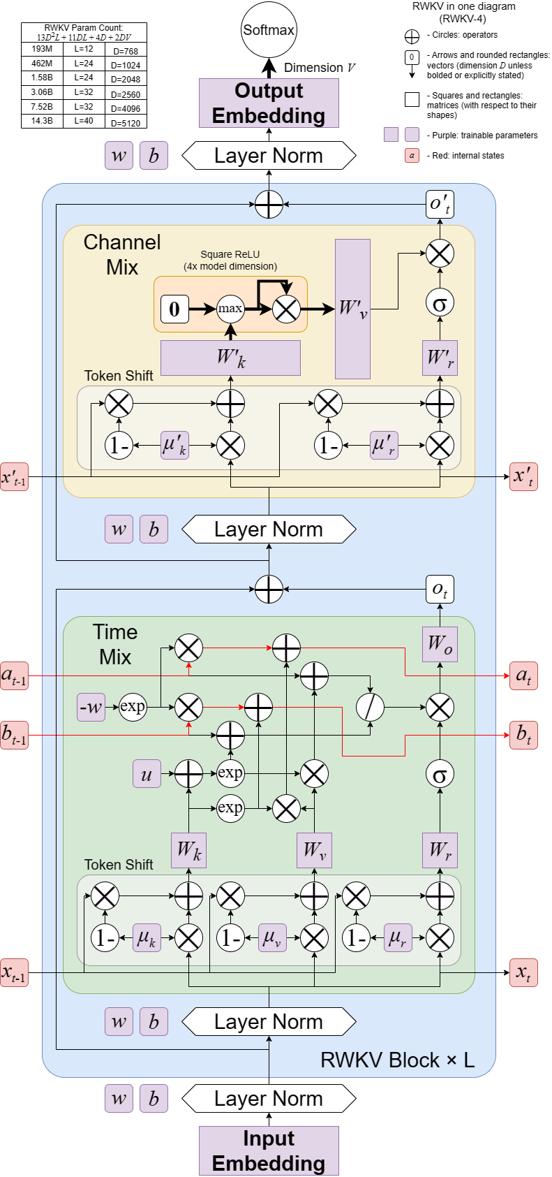
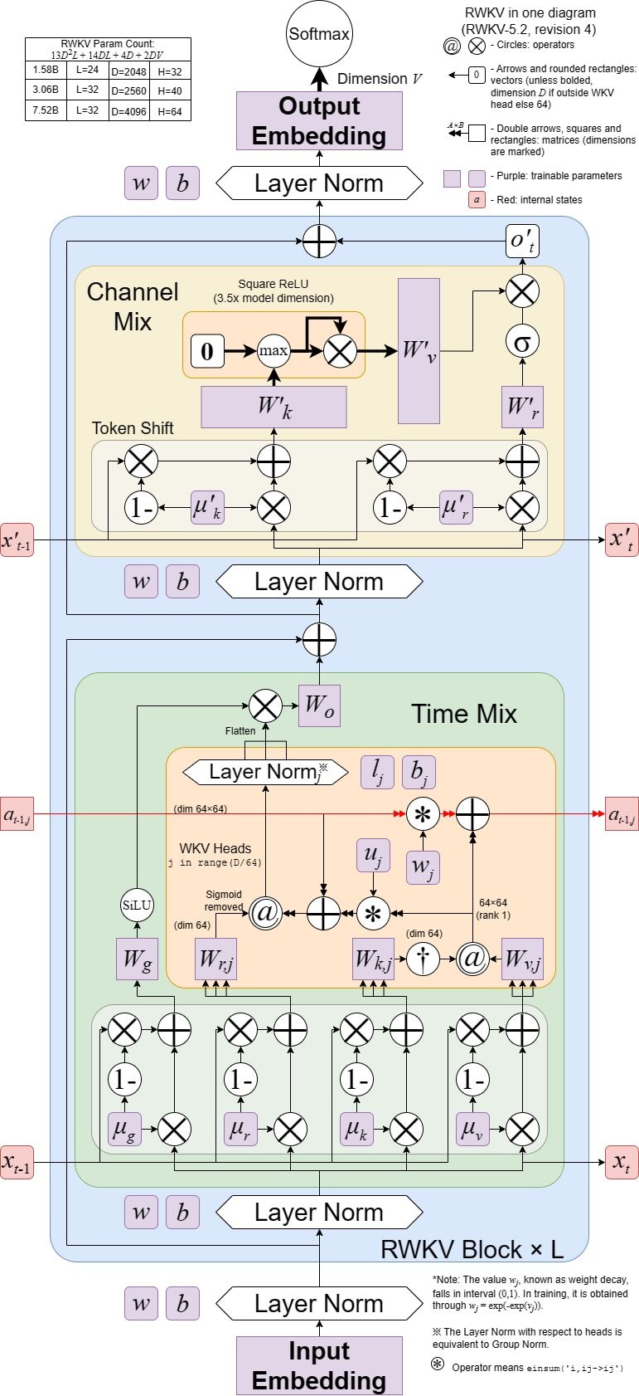
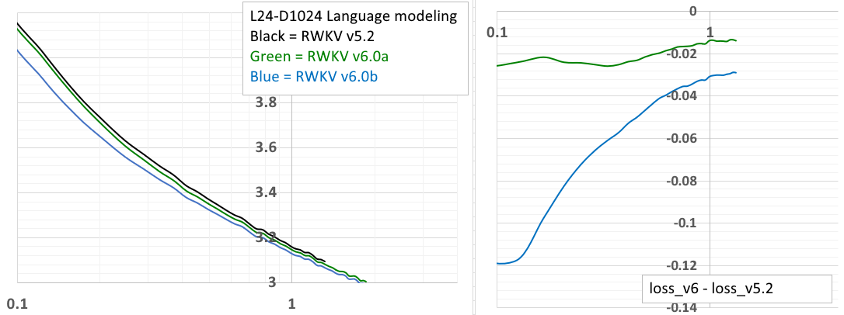

Slide 17
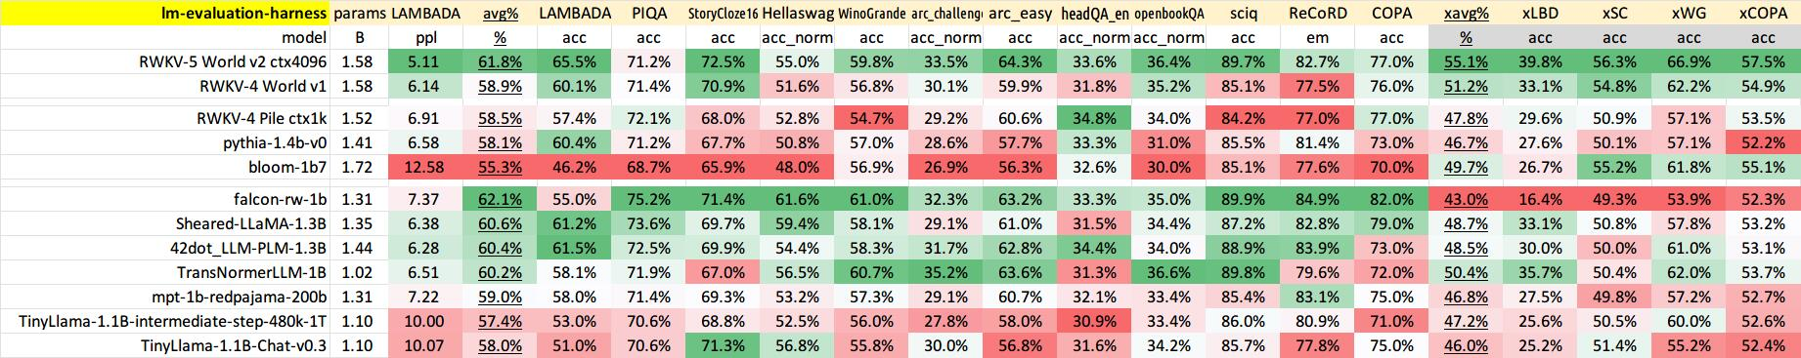
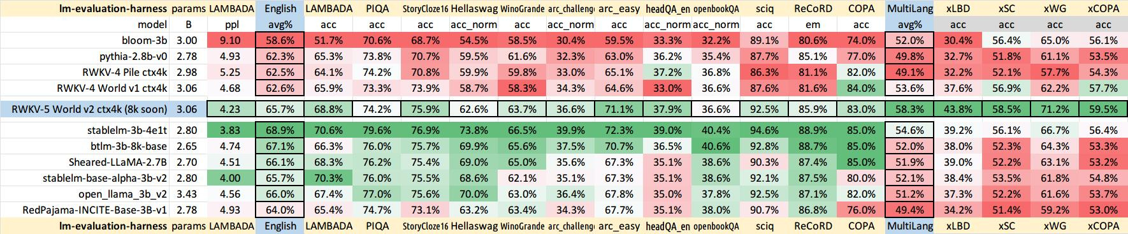
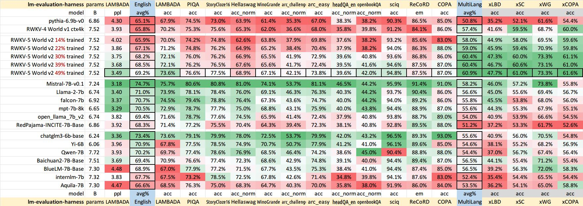

Slide 18
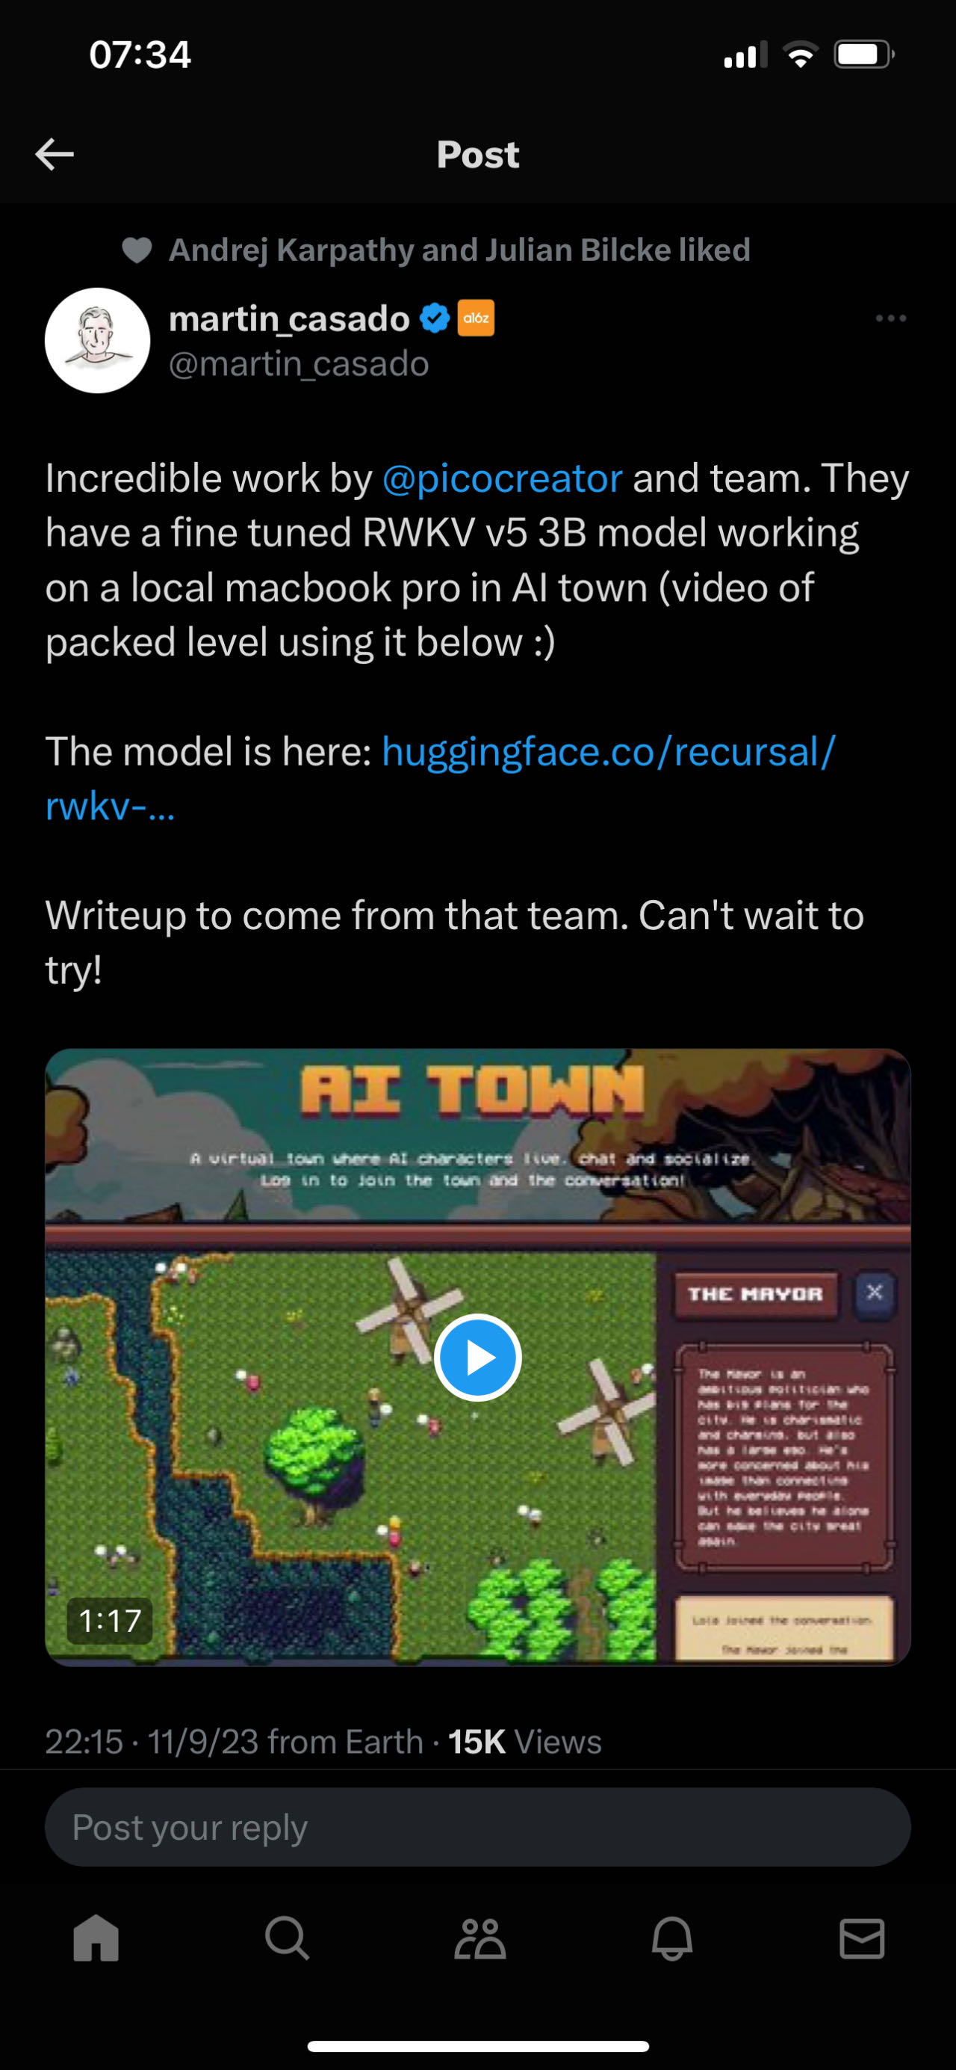
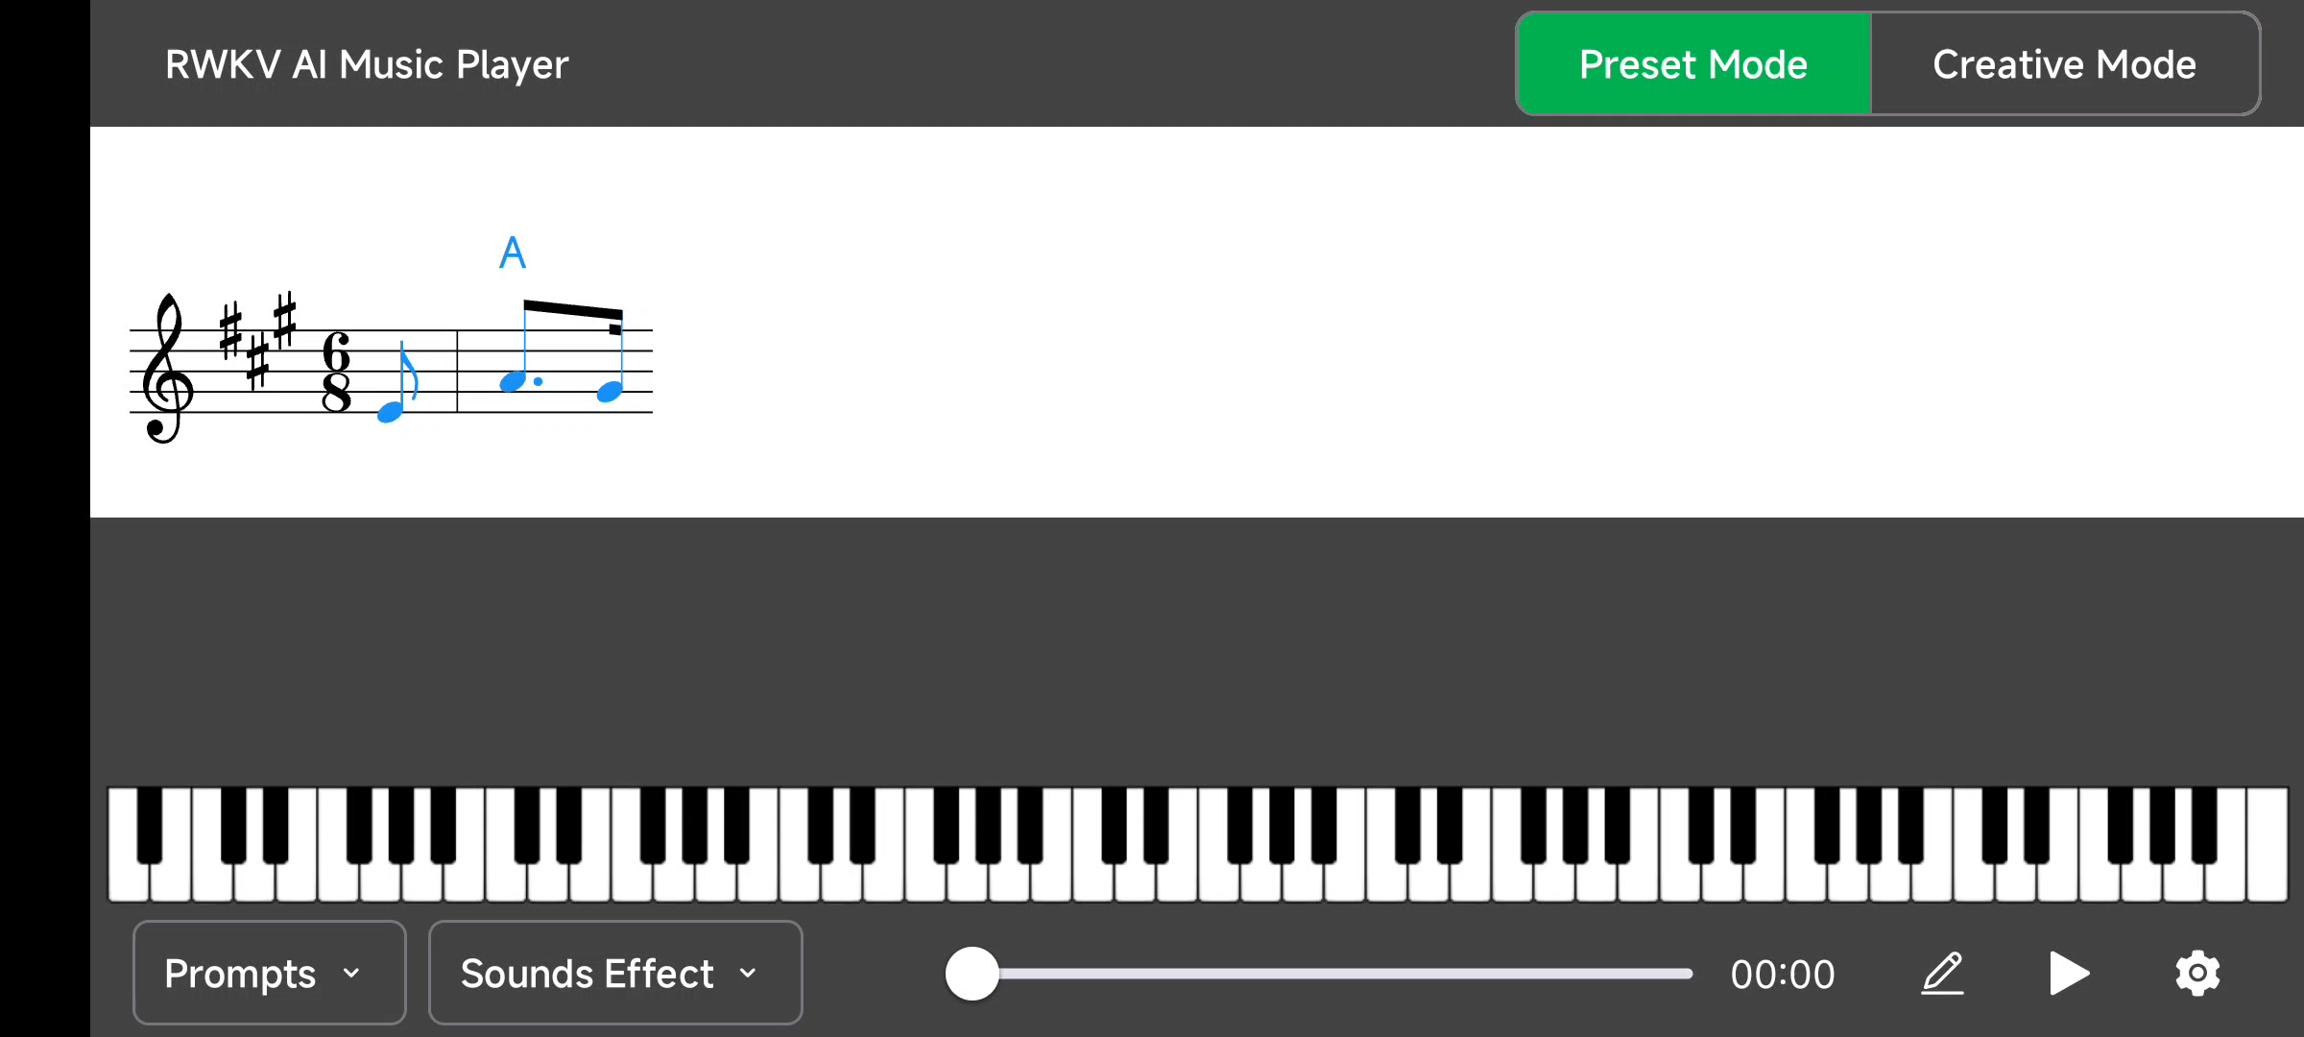

Slide 19
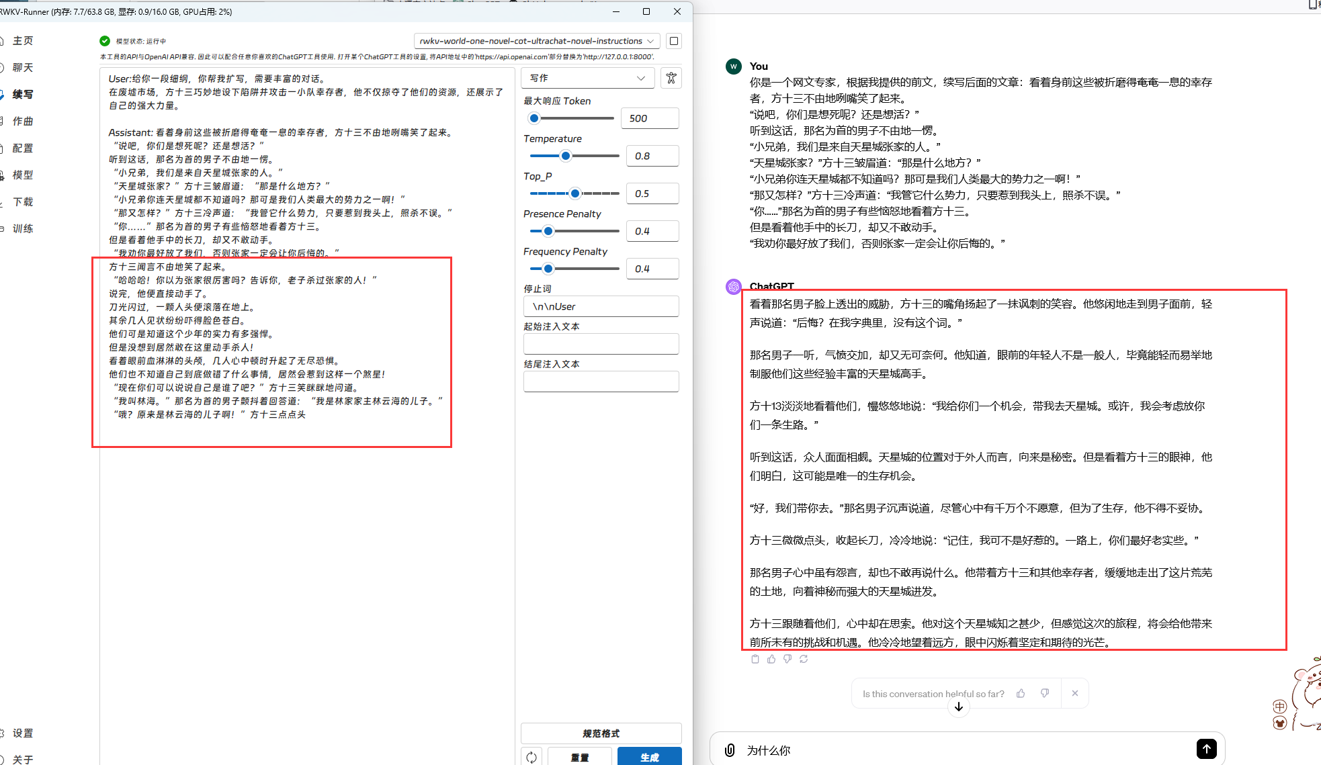

Slide 20
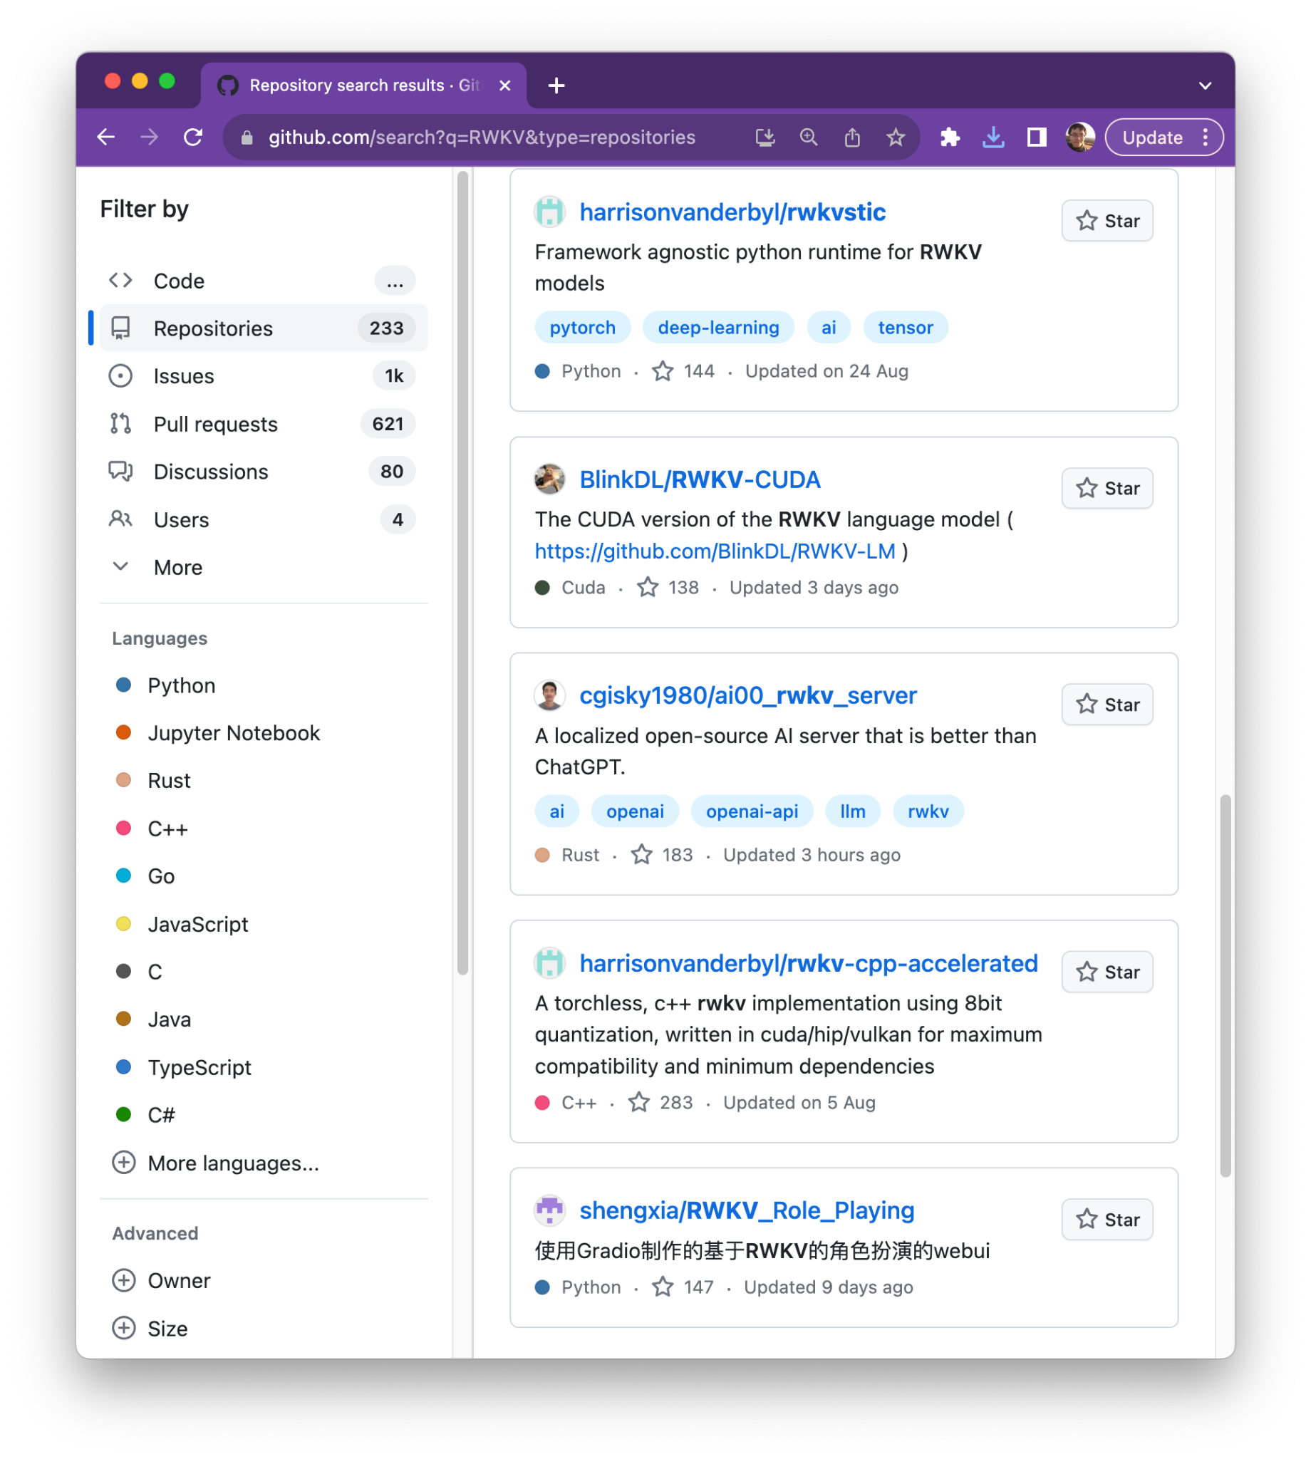

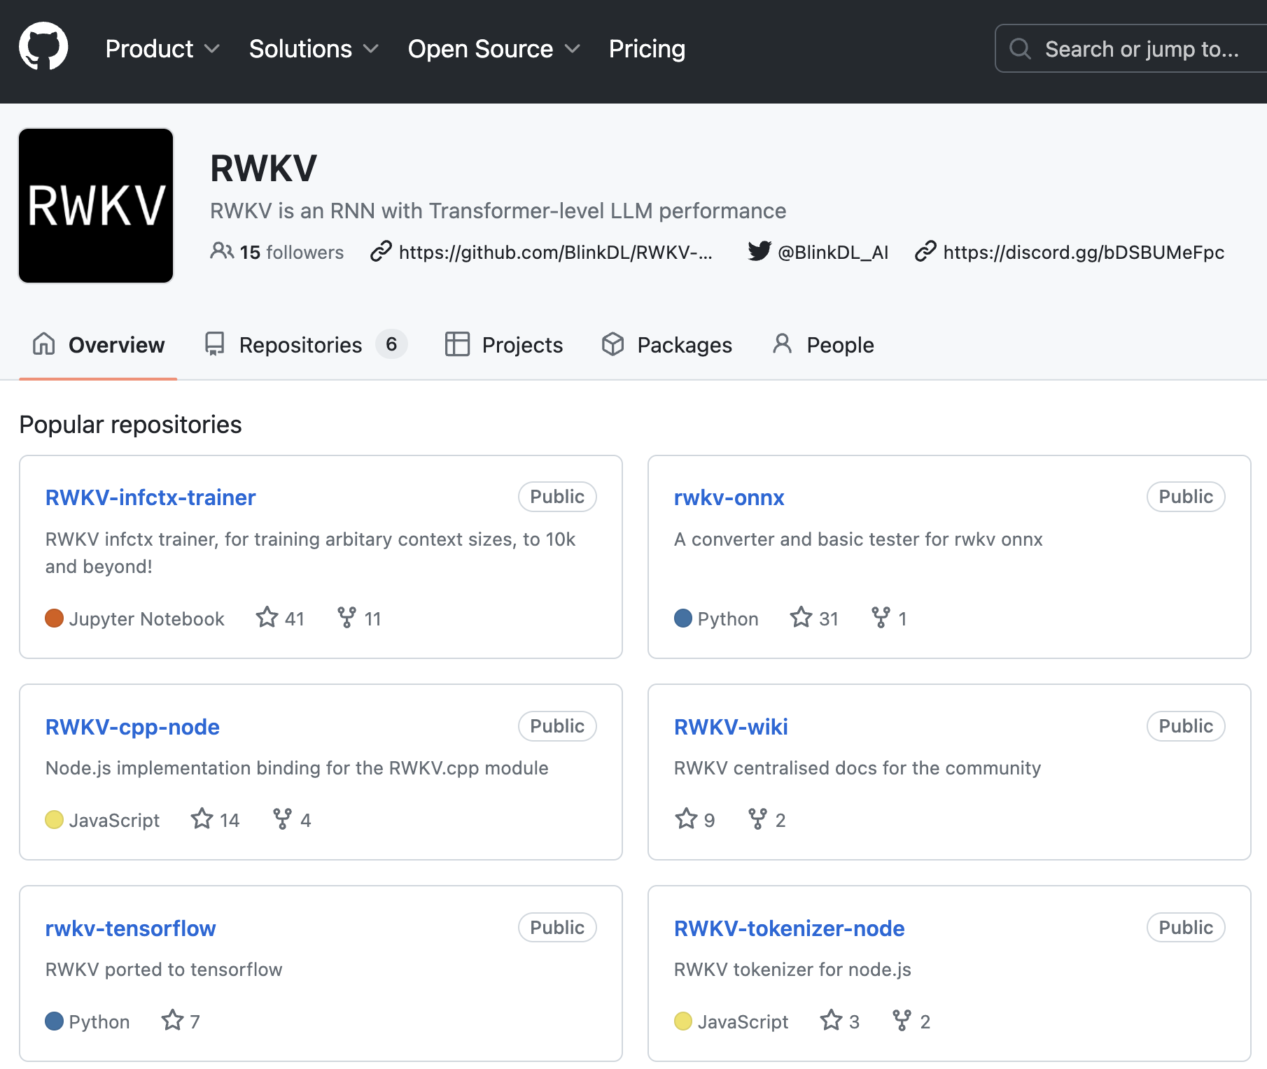
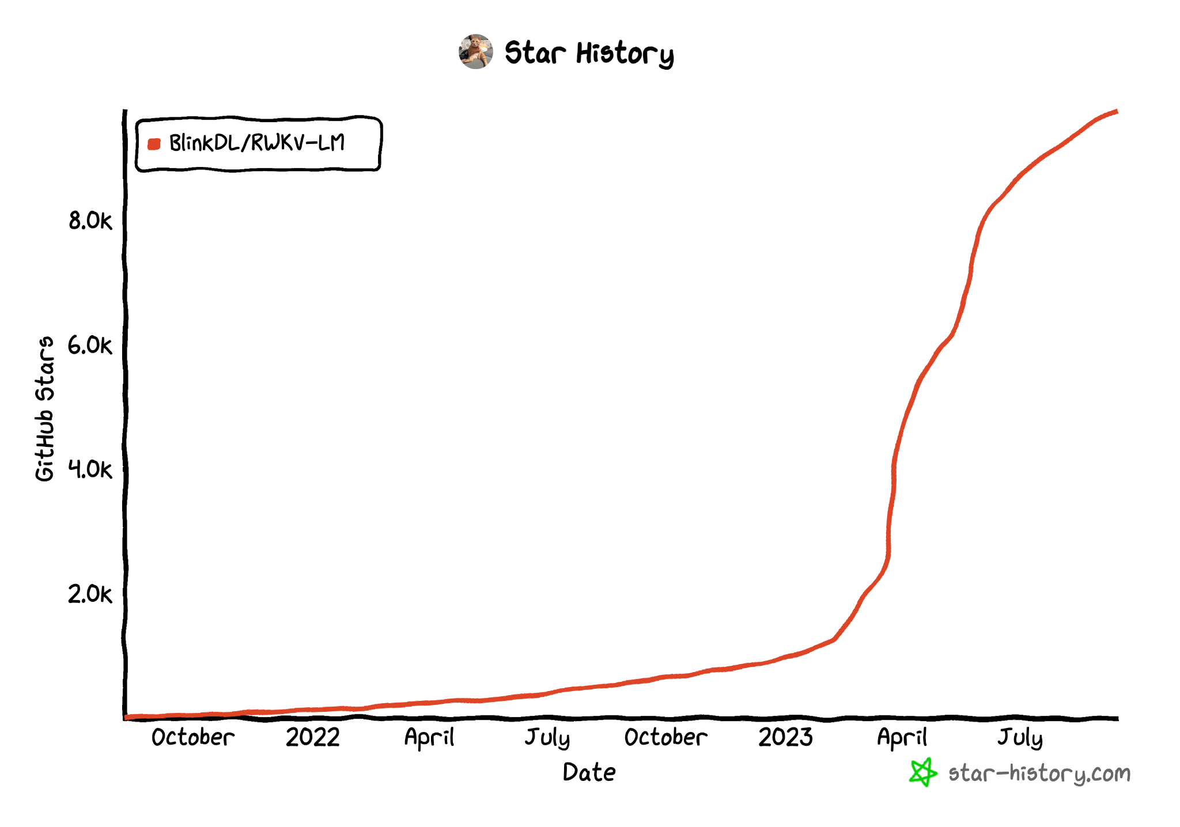

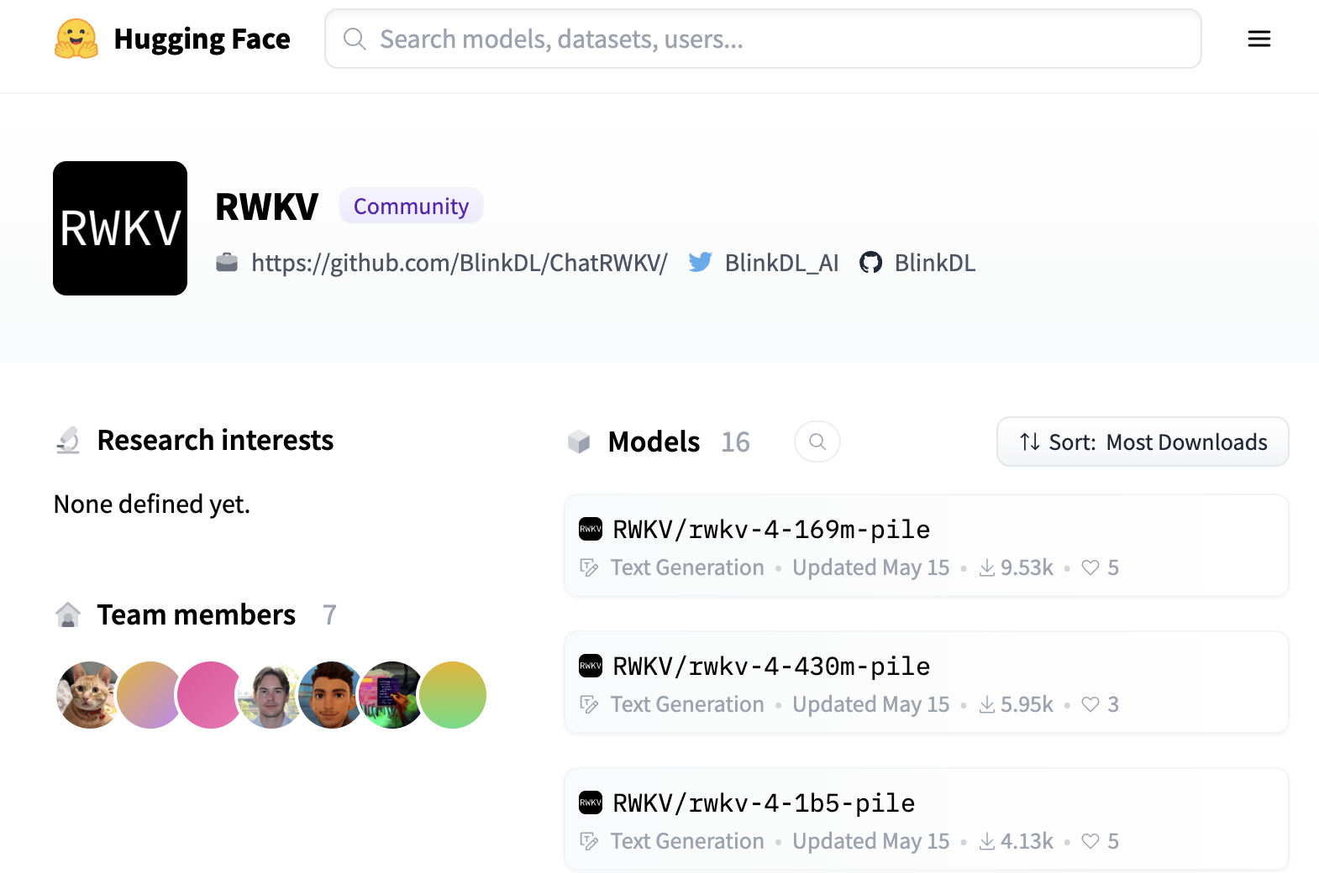

Slide 21
Problem with english based tokenizer
Character languages: 3~4 tokens each
European / Nordic words: ~3 tokens
English: ~1.5 words
GPT2 / gpt-neox / openAI based tokenizer, takes 2~4x more effort, to infer / train in non english languages

Slide 22
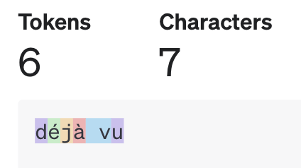



The sins of an english tokenizer
We built it on…. English Problem is not just in character languages

Slide 23
The RWKV World Tokenizer
65529 Tokens ( +5 tokens for : 2^16 )
Significantly easier to implement ( Greedy based )
Built on our world dataset of 100+ languages
Approx. 1.5 ~ 2.5 tokens per character / word
~1.5 still for english language
https://github.com/BlinkDL/ChatRWKV/tree/main/tokenizer

Slide 24
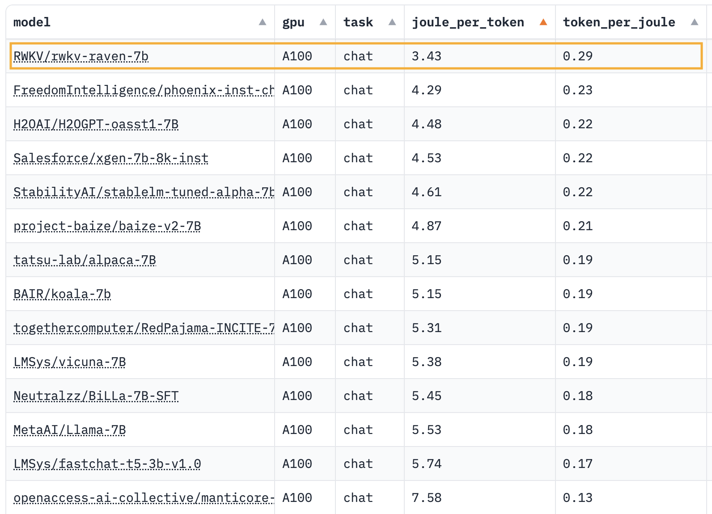
RWKV is the world’s greenest AI model (joules per token)
Benchmark done independently by: https://ml.energy/leaderboard/

Slide 25
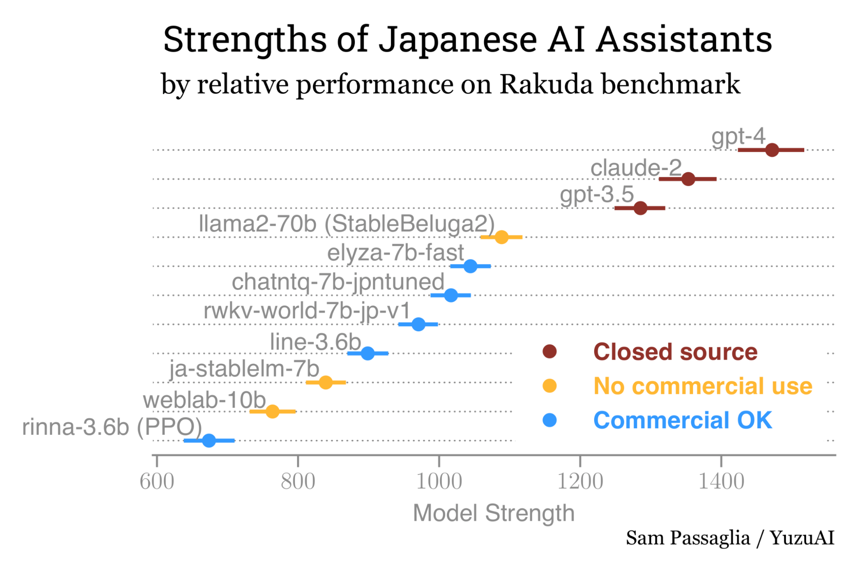
With an AI model built not just for the english speaking but the World
LLaMA2 based models

Slide 26
RWKV is the leading sub-quadratic transformer architecture alternatives
Architecture | Status | Compute Efficiency | Largest Model | Trained Token
RWKV https://arxiv.org/abs/2305.13048 | In Production | O ( N ) | 14B | 500B++ (the pile+)
Ret Net (Microsoft) https://arxiv.org/abs/2307.08621 | Research | O ( N ) | 6.7B | 100B (mixed)
State Space (Stanford) https://arxiv.org/abs/2302.10866 | Prototype | O ( Log N ) | 355M | 15B (the pile, subset)
Liquid (MIT) | Research | - | <1M | -
Transformer Architecture ( included for contrasting reference ) | In Production | O ( N^2 ) | 800B (est) | 13T++ (est)
RWKV v4 models are publicly available on huggingface, up to 8k (official) to 128k context size (community finetuned).
And is heavily in use for character persona, and multi-lingual use cases.
RWKV, RetNet, StateSpace has been proven to have comparable performance to transformers for its dataset, and param size class
Liquid Neural Network, is too early in the research stage to establish compute efficiency

Slide 27

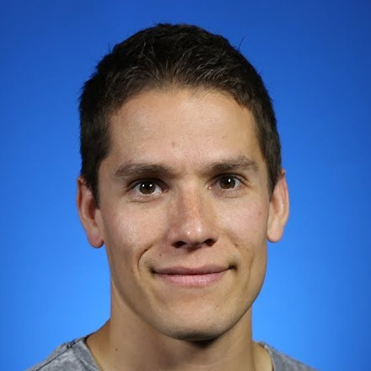
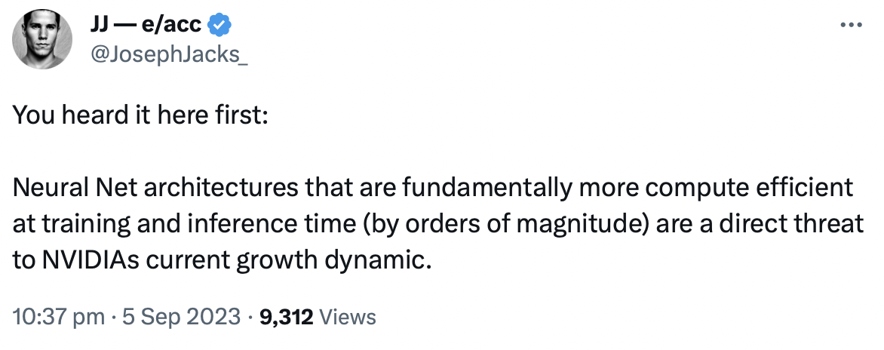



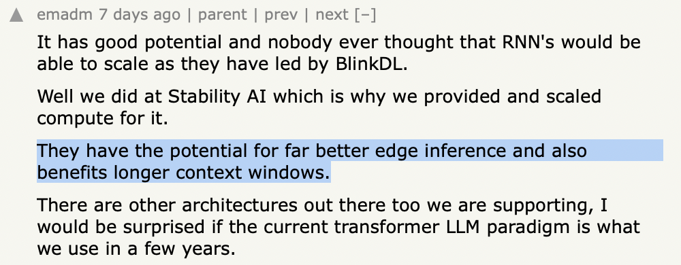
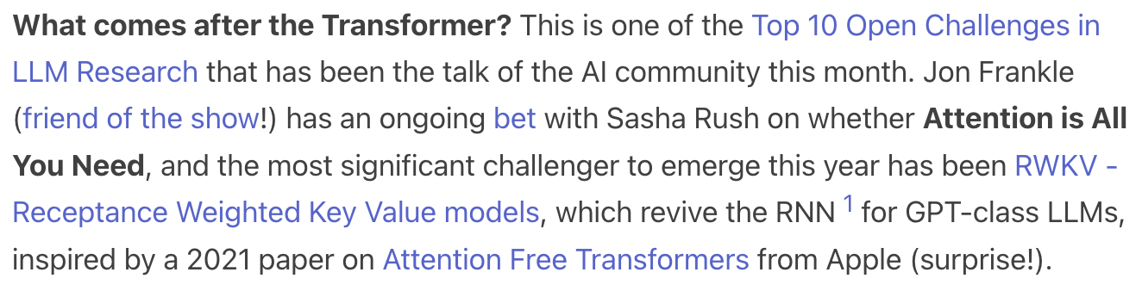

Growing support for Transformers alternatives, by major influencers in AI
(About RWKV) very interesting project and a very interesting model architecture because it has some properties of Transformers notably it's a model architecture that's very scalable in terms of training so you can stack it really deep and you can still train it and also you can parallelize training at the same time it avoids the quadratic memory bottleneck that Transformers have by essentially being an RNN
JosephJack @ GP of OSSCapital: https://twitter.com/JosephJacks_/status/1699295752638578796
Yannic Kilcher @ AI researcher, Author of OpenAssistant https://www.youtube.com/watch?v=x8pW19wKfXQ&ab_channel=YannicKilcher
Sywx @ latent.space podcast: https://www.latent.space/p/rwkv#details
Emad Mostaque @ Founder of Stability.AI: https://news.ycombinator.com/item?id=37368264
Recursively building the next generation AI models

Slide 28
Tipping Point:
RWKV v5-based model's memory sizes have reached transformer scales
Architecture | Param Count | High Accuracy Recall Size | Effective Context Length | Trained Context Length
RWKV v4 | 14 B | 400 | 800 | 8,000
RWKV v5 | 0.5 B | 600 | 1,200 | 4,000
RWKV v5 | 1.5 B | 1,900 | 3,800 | 8,000
RWKV v5 (est.) | 14 B | ~ 18,000 | ~ 36,000 | ~ 48,000
RWKV v5 (est.) | 40 B | ~ 50,000 | ~ 100,000 | ~ 120,000
RWKV v5 (est.) | 70 B | ~ 88,000 | ~ 176,000 | ~ 200,000
RWKV v5 models @ 1.5B params have been trained and benchmarked to have similar recall size, nearing transformer scale. And is found to be scalable by overall param count. The 0.5 and 1.5B tests for v5 were done with random data, on a minimally trained models, for validating the architecture changes. Projecting forward for v5, the 14 / 40 / 70B models, shows performance improvements exceeding context size beyond existing transformer models.
High Accuracy Recall Size: The ability of the model to recall, and pay perfect attention to X amount of randomized incompressible tokens with 90%+ accuracy. Effective Context Size: Most real world usage does not use randomized data, and is highly compressible. This can be observed in v4 14B models being able to translated documents over 2k
context size (Despite its limited recall size), due to its ability to compress such data within its recall size. This process is a highly lossy process, similar to humans, with tokens being expected to be discarded (by least importance) after this context size. Trained Context Size: The context size the model has been trained to handle up to (or we plan to train up to)

Slide 29
.

Slide 30
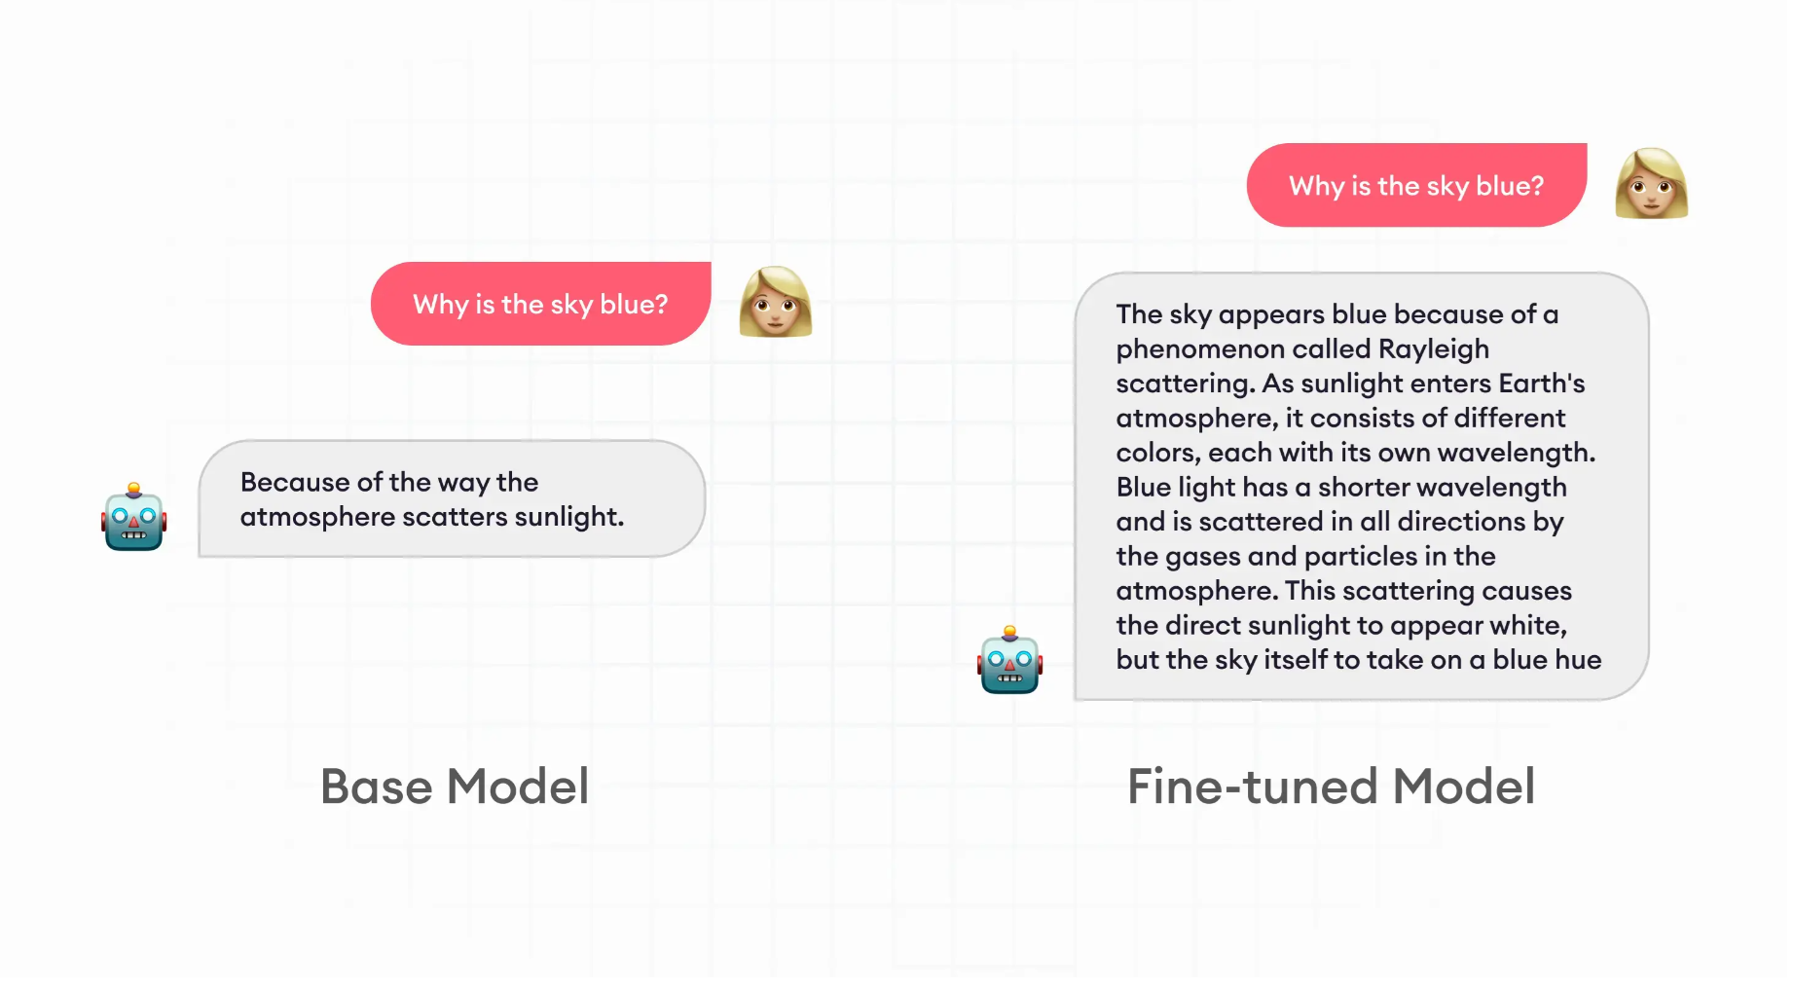

Slide 31
